Slide 1
311 Mid-Semester Updates
Team B

Slide 2
Project Description
The City of Boston seeks a comprehensive analysis of animal-related reports submitted through the city's 311 application. This report should encompass the volume of complaints received, the species of animals involved, the specific localities where such complaints are prevalent, and any discernible patterns within these complaints, including seasonal variations or meteorological influences.

Slide 3
Previous Questions:
How many reports were filed in the previous 2-3 years and 5-10 years, and are there any discernible trends in these reports, such as increases or decreases in total numbers?
What types of animals are most commonly reported in complaints?

Slide 4
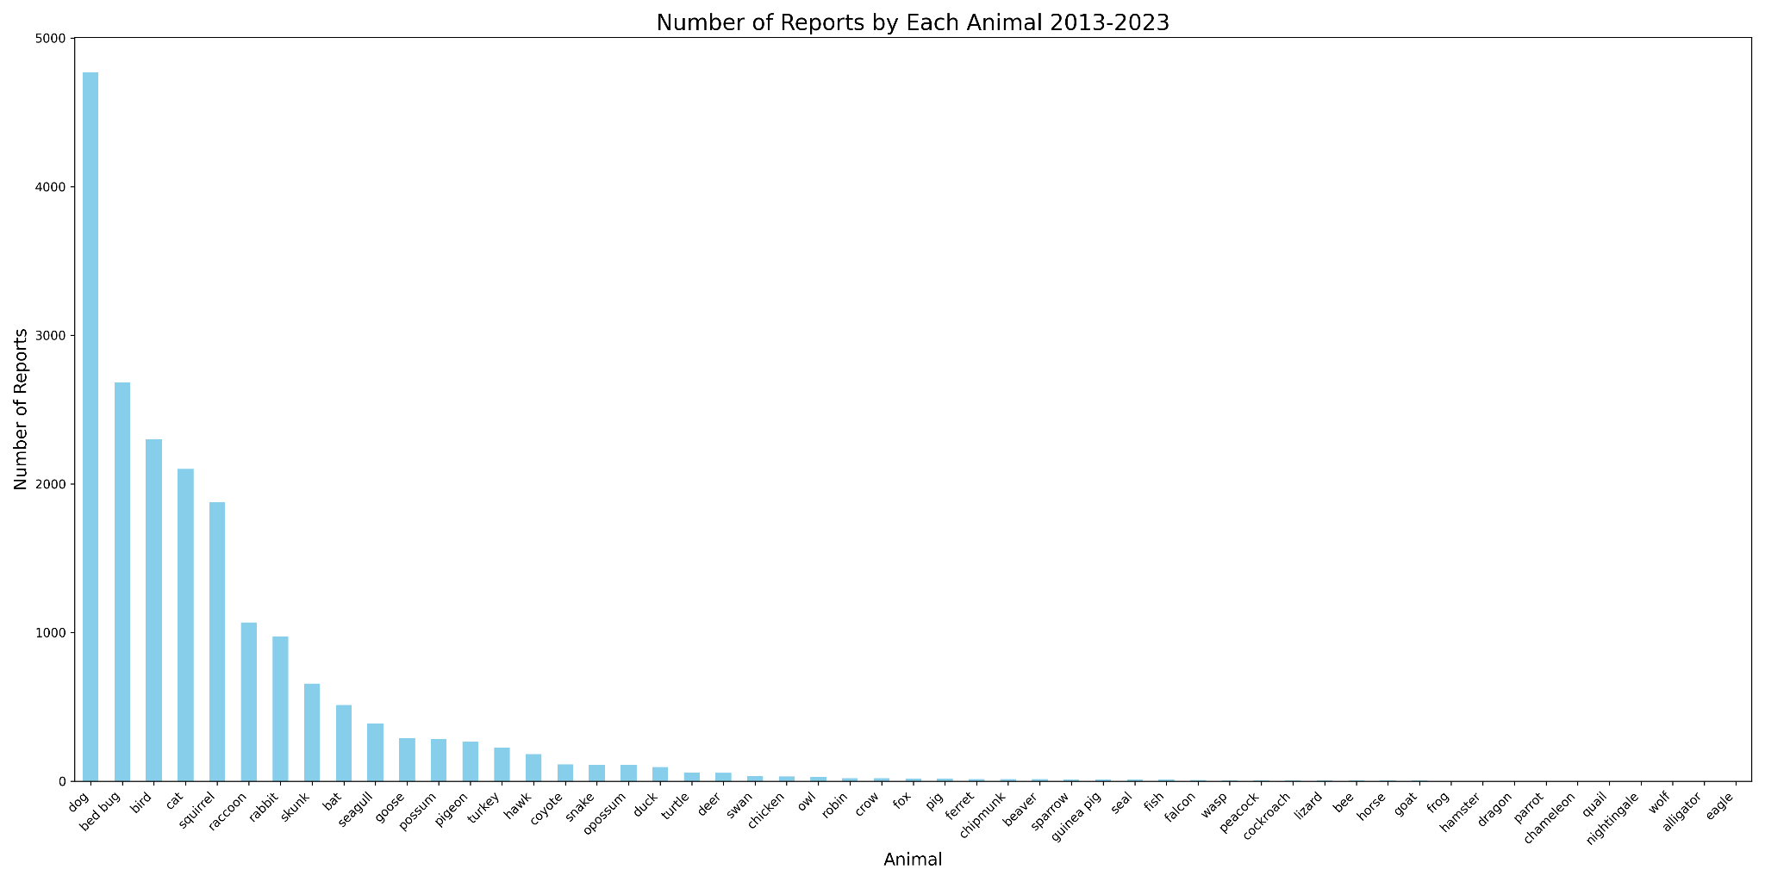
Updates made from Early Insights Report
Figure 1: This bar graph illustrates the frequency of animal-related complaints, highlighting dogs, bedbugs and birds as the most commonly reported issues over the selected time frame.
Notes:
Updated the animals and the number of complaints; got rid of rodents as mentioned before and now the top animal with the most amount of complaints are digs Reasons for Frequency by Animal Type:
Population and Urbanization: Dogs and birds are common in urban areas, and as the human population grows, encounters with these animals may increase.
Housing Conditions: Bedbug infestations are often associated with high-density housing and can spread quickly in apartment complexes, which might be prevalent in certain areas of Boston.

Slide 5
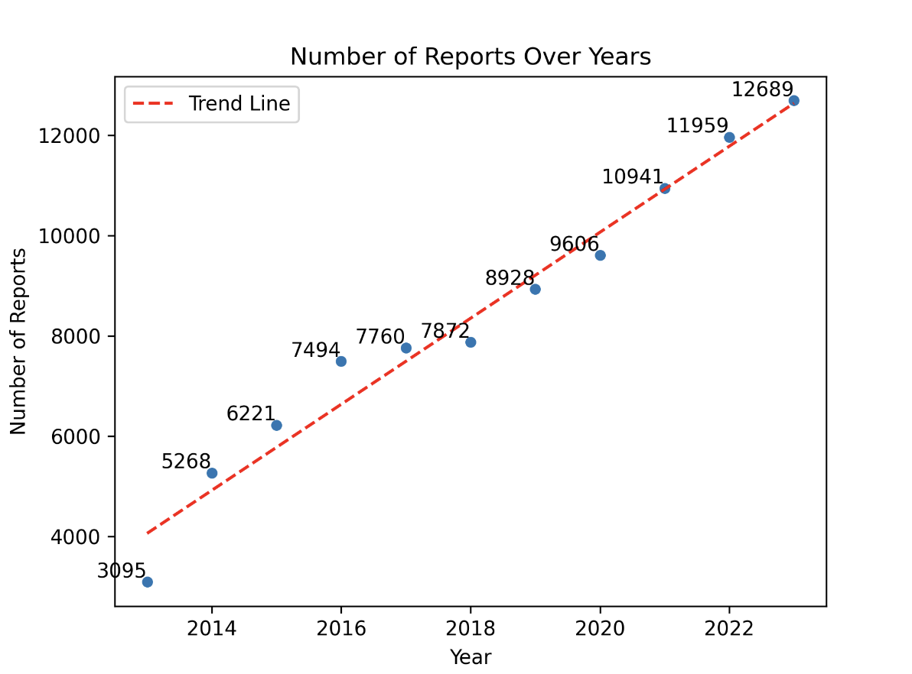
Updates made from Early Insights Report
Figure 2. This scatter plot shows a clear ascending trend in animal-related complaints in Boston from 2013 to 2023, with a trend line highlighting the steady increase in reports over time.
Notes:
Updated the time series

Slide 6
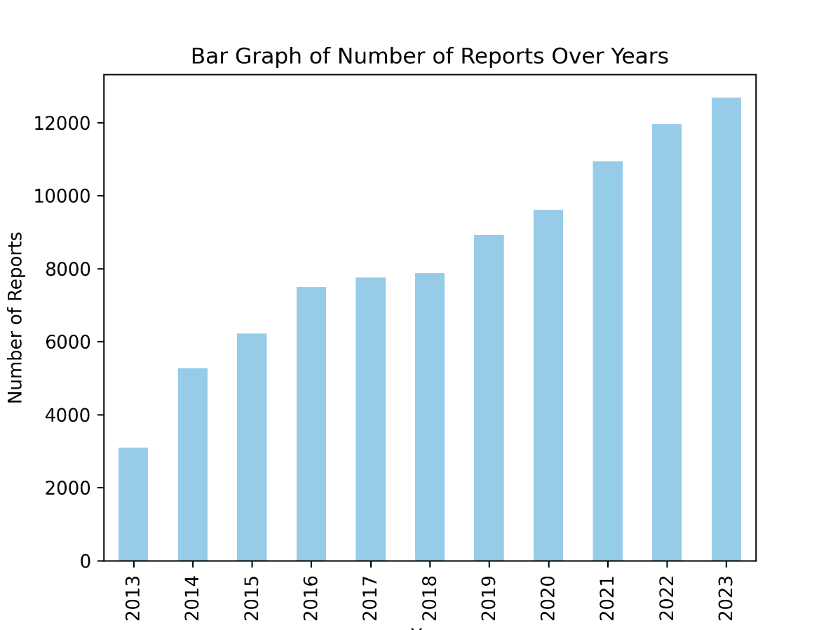
Updates made from Early Insights Report
Figure 3. The bar graph illustrates a consistent year-over-year rise in animal-related complaints, with a notable surge in reports starting from 2020.
Notes:
Updated the time series
Reasons for Increasing Trends Over Years:
Growing Population: An increasing human population can lead to more interactions with animals, resulting in more complaints.
Reporting Awareness: There could be increased public awareness and reporting efficiency, leading to higher numbers of recorded complaints.
Environmental Changes: Changes in urban wildlife habitats and climate may affect animal behavior, leading to more frequent human-animal interactions.

Slide 7
Updated Implications
Targeted responses
Dogs: leash laws and waste disposal
Bedbugs: pest control initiatives, guidelines for landlords and homeowners to combat infestations
Resource planning
Consistent rise indicates the need for more resources dedicated to animal control and public health
Develop long-term strategies to address the root causes

Slide 8
Where are the complaints coming from geographically? Is there any trend to type of animal complaint and area?

Slide 9
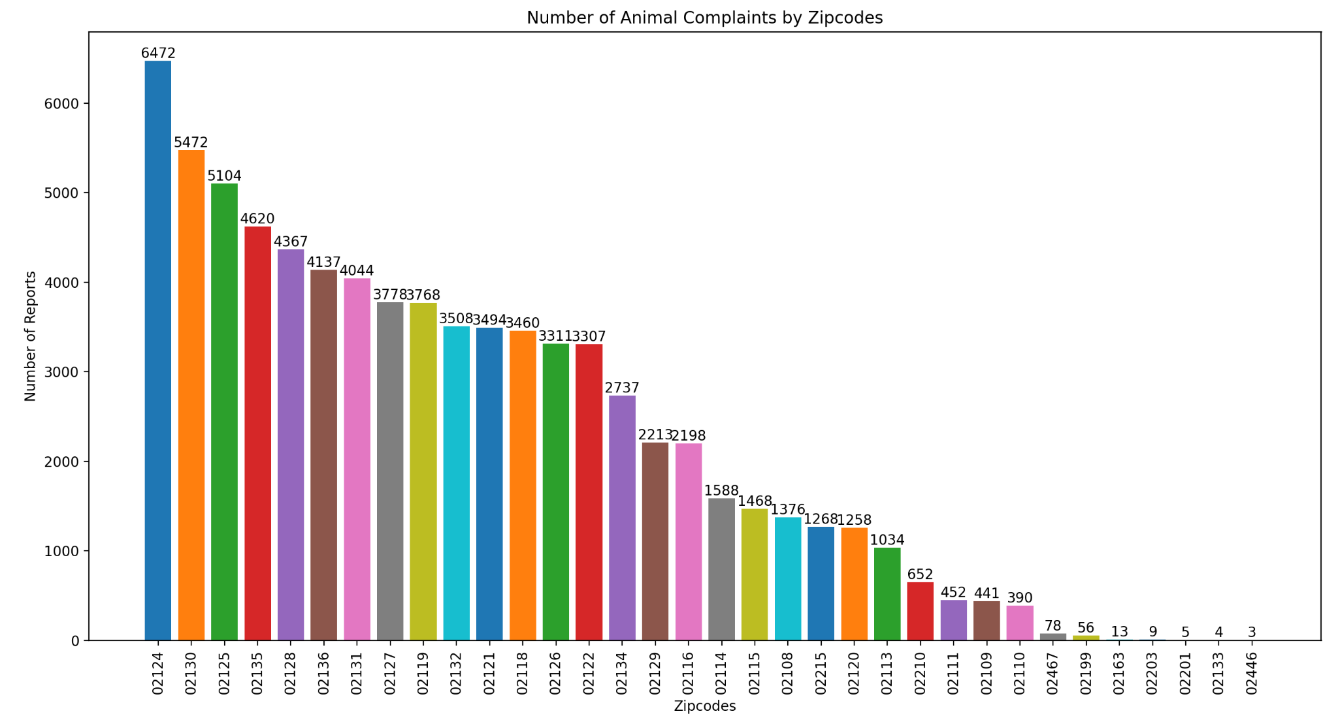
Figure 4: The bar chart of animal complaints by zip code reveals a significant variation ranging from a high of 6,472 in the 01224 area to a low of 3 in the 02446 area.
Notes:
During the last client meeting we had this bar chart: animal complaints by neighborhoods and was suggested to use zipcodes instead because neighborhood borders can get complicated however zipcodes cant be changed.
Figure X: Bar chart representation of the number of animal complaints categorized by zip code areas. The data illustrates a clear disparity in the frequency of complaints, with the highest number of reports being in the 01224 zip code area, reaching a peak of 6472 complaints. A descending pattern is evident as the number of complaints decreases progressively across the subsequent zip code areas. The chart shows a broad range of data, with the lowest number of complaints recorded in the 02446 zip code area, with only 3 reports. This visual aids in identifying potential hotspots for animal-related incidents and could be pivotal in allocating resources for animal control services more efficiently.

Slide 10
Top 5 Zip Codes:
02124: 6472 reports | Most Common Complaint: 'Pick up Dead Animal' with 2721 complaints.
02130: 5472 reports | Most Common Complaint: 'Pick up Dead Animal' with 2713 complaints.
02125: 5104 reports | Most Common Complaint: 'Pick up Dead Animal' with 2473 complaints.
02135: 4620 reports | Most Common Complaint: 'Pick up Dead Animal' with 2114 complaints.
02128: 4367 reports | Most Common Complaint: 'Pick up Dead Animal' with 1843 complaints.
Notes:
Drastic difference from when we split it by neighborhoods because the top neighborhood was Dorchester: 15972 reports: Most Common Animal Complaint: 'Pick up Dead Animal' with 7437 complaints. Which is different with the top zipcode witht he most amount of complaints

Slide 11
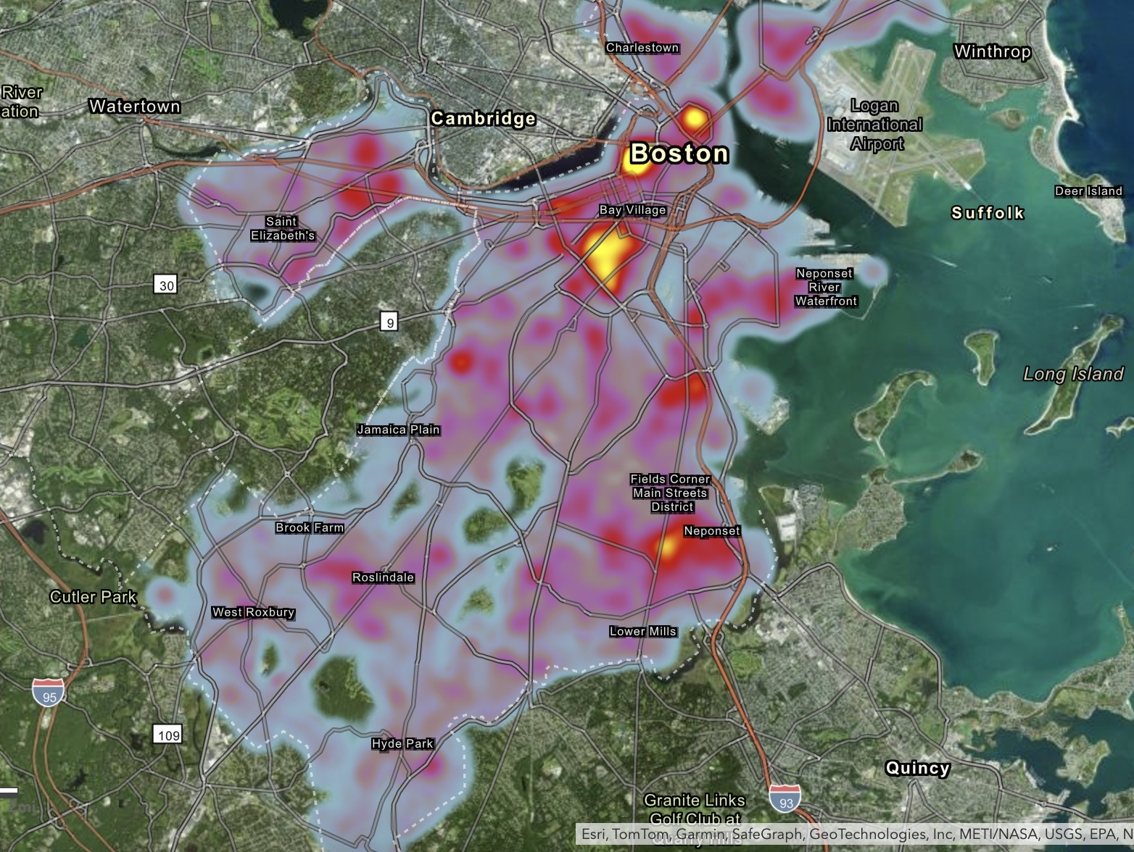
Heatmap - Total Reports
Notes:
Possible link to the head map? Can be used to visually show (zooming in and out)

Slide 12
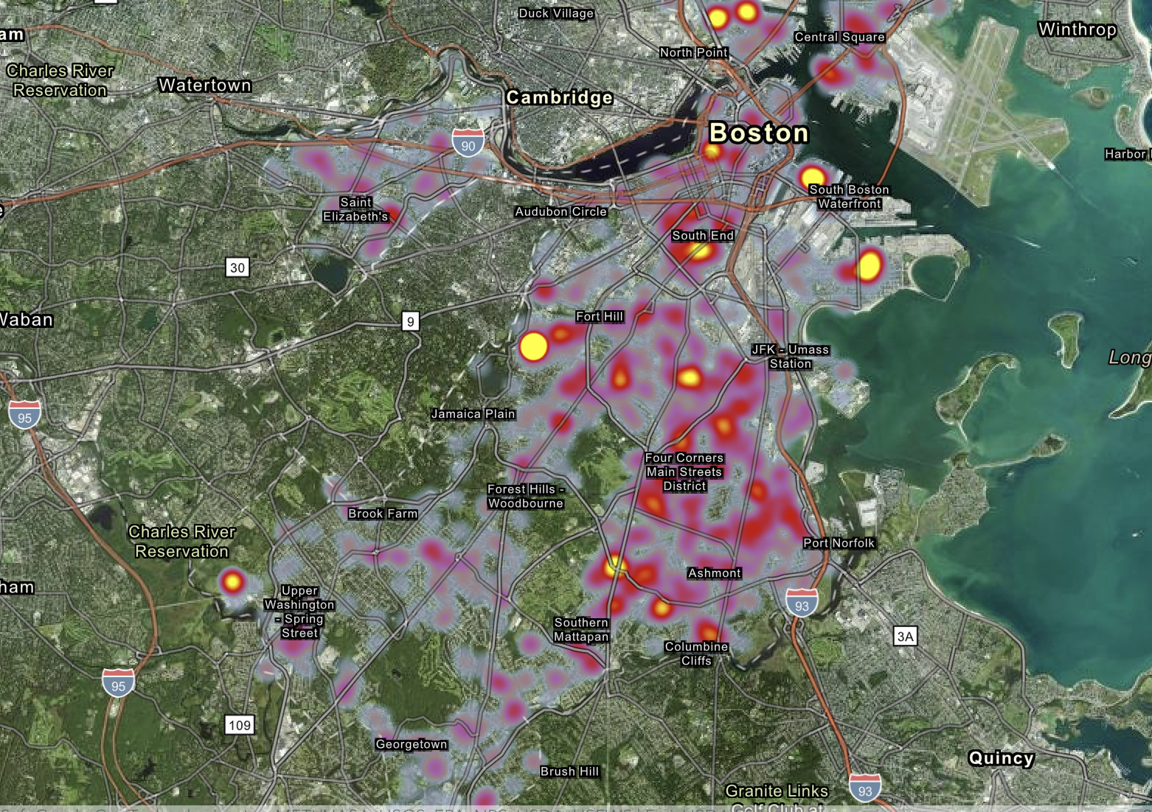
Dog Reports - 2023

Slide 13
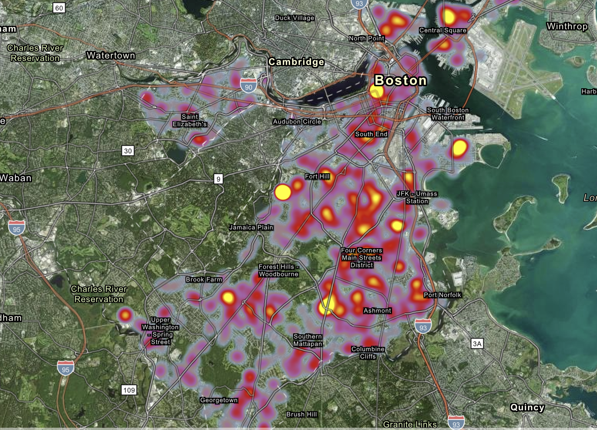
Dog Reports - 2022

Slide 14
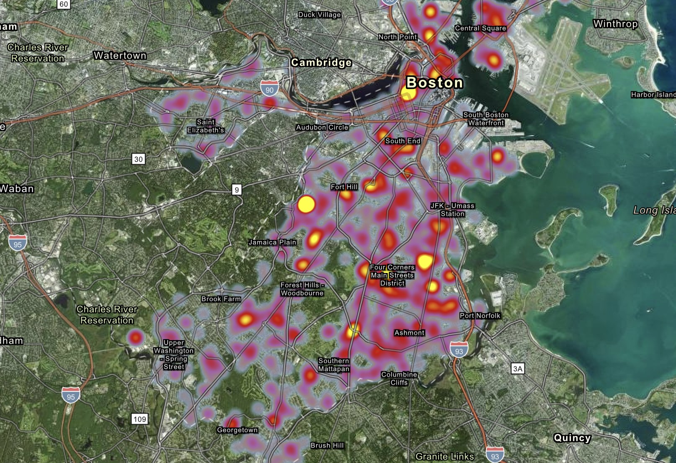
Dog Reports - 2021

Slide 15
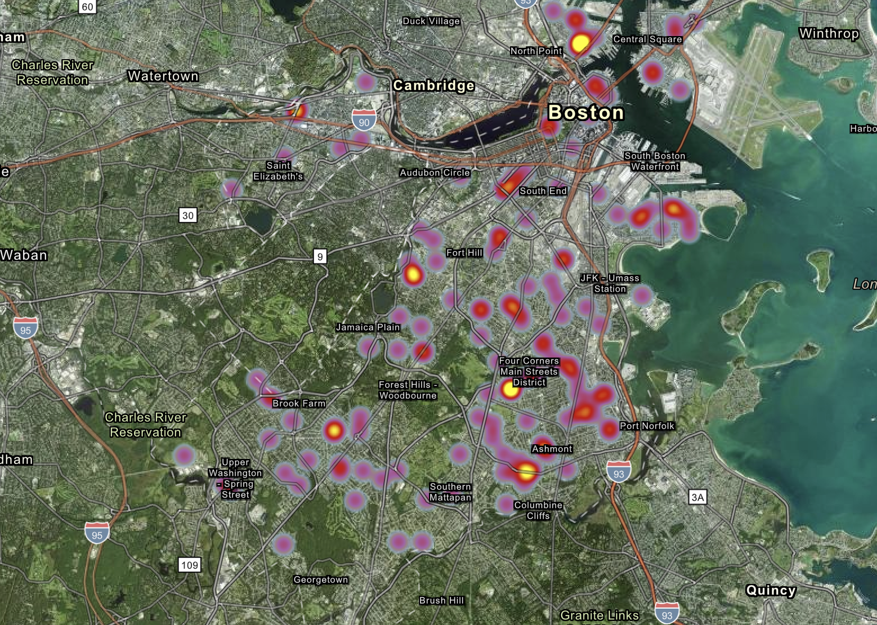
Dog Reports - 2020
Notes:
Big decrease from 2021

Slide 16
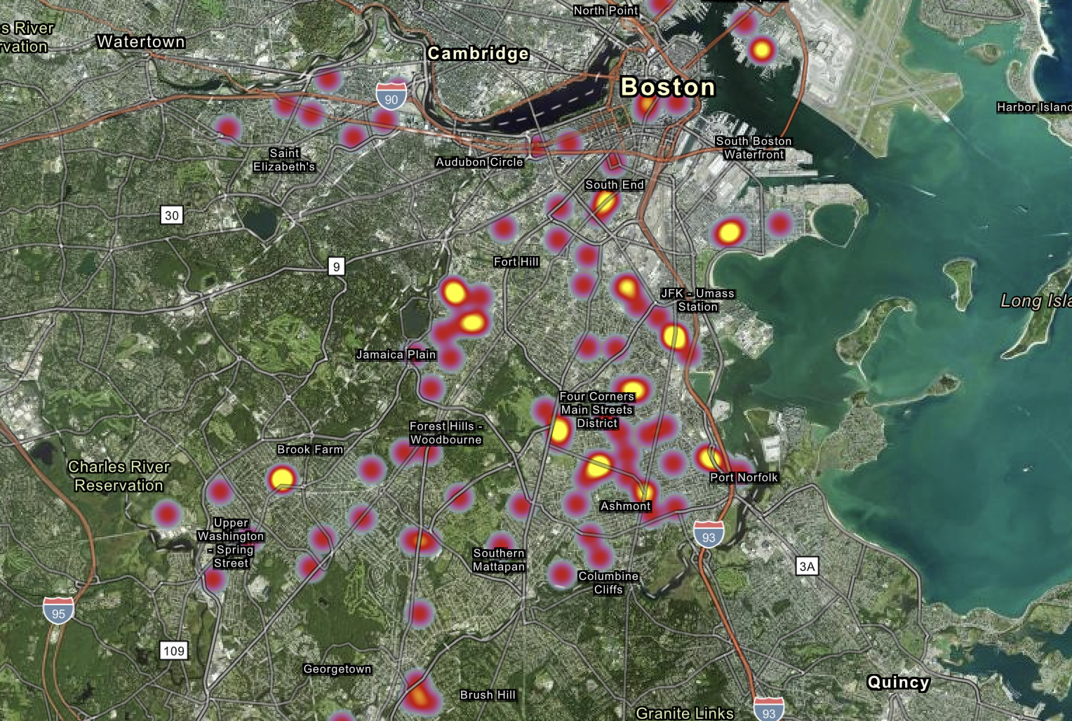
Dog Reports - 2019

Slide 17
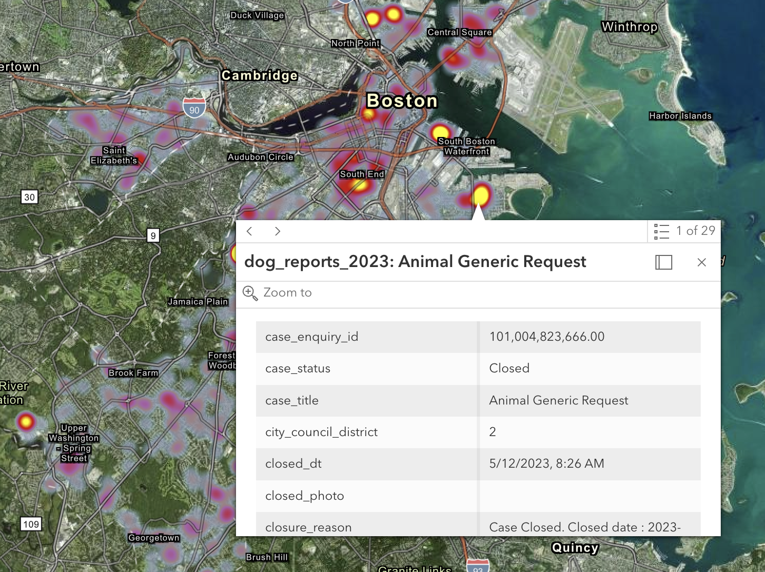
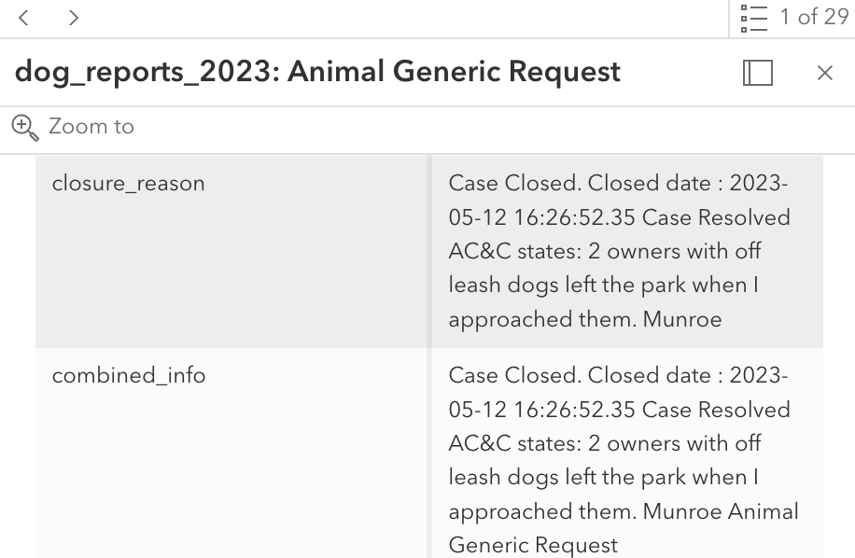
Interactive maps - https://arcg.is/1H0ea9
Notes:
Allows you to interactively click on points within the maps and see all the info pertaining to the incidents that happened in that spot (in the example i clicked on theres 29 incidents and you can toggle between them)

Slide 18
Key Insights for Q1
High density areas
More prone to issues requiring animal control services
Animal carcasses
Widespread issue requiring city attention
Zip codes with lower frequency of complaints
Lower population of animals, better animal control measures, or fewer residents reporting in those areas
Notes:
High-density areas, potentially urban environments, are likely generating more complaints, as evidenced by the high counts in certain zip codes.
The sharp drop-off in complaints in the later zip codes suggests that these might be more rural or have less human-animal interaction.

Slide 19
Implications for City of Boston
Resource Allocation
Allocate more resources, such as animal control officers and cleanup crews, to zip codes with more complaints
Public Awareness
Inform the public about responsible pet ownership, road safety to prevent animal accidents, and the importance of reporting dead animals
Investigate Underlying Issues
High traffic, proximity to natural habitats, or other factors?

Slide 20
How do other factors such as season impact the nature of the complaints?

Slide 21
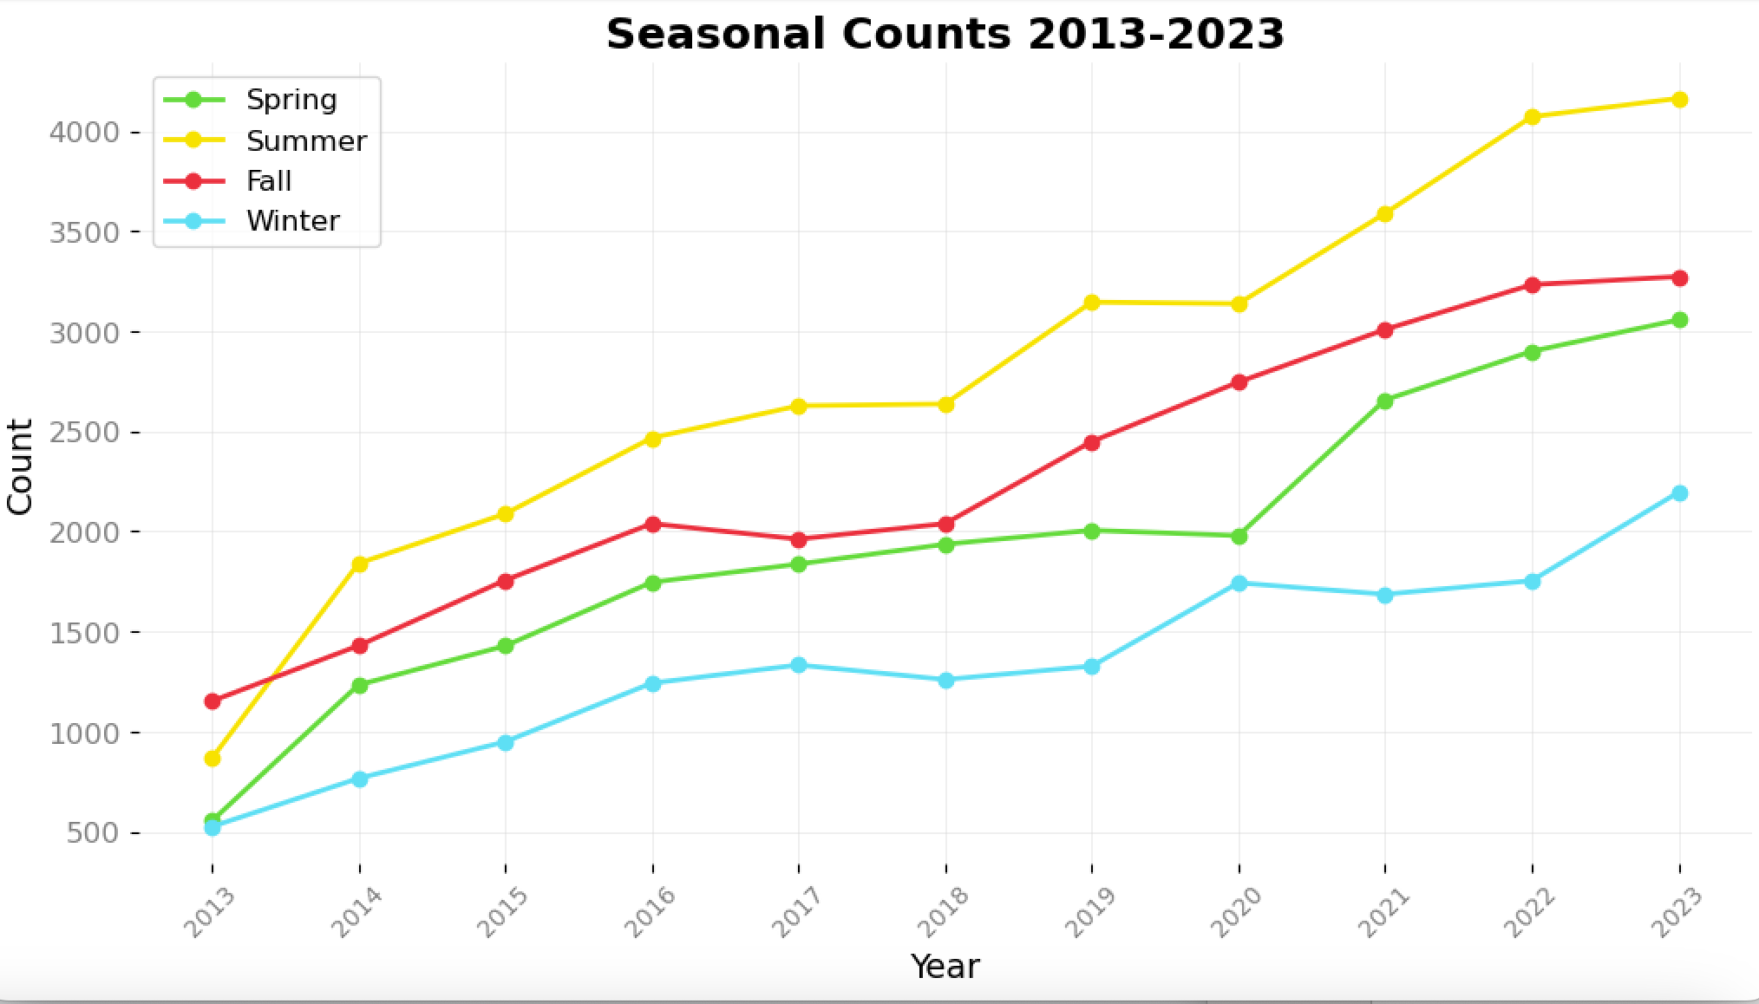
Figure 3: depicts a line graph showing seasonal variation in counts from 2013 to 2023, with spring consistently having the lowest counts and summer showing the highest, indicating a possible correlation between seasonality and the recorded metric.
Notes:
Overall Trend: All seasons show an increasing trend in counts from 2013 to 2023.
Seasonal Peaks: Summer has the highest counts, winter has the lowest.
Growth Rates: Spring and summer exhibit a steady rise, while fall and winter have slower growth rates.
Warmer Weather: Animals are more active during warmer months, leading to more human-animal interactions.
Increased Human Activity: People tend to spend more time outdoors in the summer, possibly leading to more reports.
Breeding Season: Many species have their breeding seasons in the spring or early summer, which could result in a noticeable uptick in animal sightings or issues.
Visibility: Animals might be more visible as they search for food and water during hotter periods, when foliage is less dense.

Slide 22
Key Insights for Q2
Peak during Summer
Higher activity levels for both humans and animals
Lower number of complaints in Spring
Animals coming out of hibernation or less human outdoor activity in the early part of the season
Breeding season in Spring or early Summer
Visibility and accessibility in colder months
Snow and ice in winter might obscure carcasses
Difficult for residents to access areas where they might encounter animal issues
Notes:
Seasonality has a significant impact on the counts, which could reflect the behavior patterns of animals or the likelihood of human-animal encounters varying by season.
The overall upward trend across all seasons suggests an increasing frequency of events leading to complaints over the years.
The consistent peak during summer months could necessitate more focused animal management strategies in this period.
The winter months consistently have the lowest counts, which could influence resource allocation for the responsible agencies during this time.

Slide 23
Implications for City of Boston
Preventative measures
Plan ahead for summer surges in complaints
More animal control staff during this season
Season-specific educational campaigns
Educate the public on how to handle animal encounters and when to report them
Habitat management
Habitat management strategies to prevent negative human-animal interactions

Slide 24
Limitations
Causal analysis
Graphs present trends and count, but do not explain why
Demographic data
Could be crucial in understanding why some areas have more complaints than others
Potential reporting bias
Increases in reports over time could reflect increased public awareness and reporting rather than a true increase in incidents
Underreporting from certain demographics or regions
Notes:
﻿﻿﻿Key Findings from the Base Analysis: Summarize the major insights and discoveries from your initial analysis. Talk about some of the assumptions you had to make and the limitations of the interpretations / answers you are claiming

Slide 25
Potential Extended Questions
Question 1: How does the time of day impact the nature of the complaints?
Patterns of activity
Human-wildlife interaction
Effectiveness of control measures
Question 2: How does the proximity to parks and green spaces impact the animal-related complaints? Are there more animal-related complaints in areas closer to parks or green spaces within the city?
Habitat influence of complaints
Influence of urban planning
Effectiveness of green space management
Notes:
Question 1:
Patterns of Activity: Different species have varying levels of activity at different times of day. Insights could reveal whether nocturnal animals, like raccoons, cause more complaints at night, or if daytime animals, like squirrels, are more active and therefore reported more during the day.
Human-Wildlife Interaction: The time of day might also reflect human activity patterns and how they intersect with animal behaviors. For instance, complaints about dogs might be higher during early morning and late afternoon when people are more likely to walk their pets.
Effectiveness of Control Measures: Understanding which animals are more active and problematic at certain times can help tailor control measures, such as scheduling animal control patrols at peak complaint times.
Question 2:
Habitat Influence on Complaints: Areas close to natural habitats may have higher instances of wildlife encounters, potentially leading to more complaints about certain species like birds or deer.
Influence of Urban Planning: Insights might suggest how urban planning and the placement of parks and green spaces affect human-animal interactions, with implications for how new developments are designed.
Effectiveness of Green Space Management: The relationship between complaints and proximity to green spaces could inform how these areas are managed, such as maintaining boundaries or creating buffer zones to minimize negative encounters.
Public Education Needs: If there are indeed more complaints near parks, this could highlight the need for targeted public education on safely sharing spaces with wildlife.

Slide 26
Thank you!
Notes:
Surroinding envirment

